Slide 1

.NET STANDARD: THE ROUTE TO PLATFORM INDEPENDENCE
Kathleen Dollard
.NET Team, Microsoft
@KathleenDollard
kdollard@microsoft.com

Slide 2
Microsoft is moving to an Open Source and cross platform world, and they've created .NET Standard as a super-highway to get you there.
With the .NET Standard 2.0 release, the specification includes most of the API's you depend on in the .NET full framework (.NET 4.n). Because .NET Standard, .NET Core, Xamarin and UWP are all embracing this standard, your class libraries can easily be cross-platform.
In this session, you'll learn more about the goals of .NET Standard and how it differs from PCLs (Portable Class Libraries).
You'll also see how to use the .NET Portability Analyzer to find any changes your app needs.
To show that .NET Standard is not actual magic, you'll learn a little about how redirects support binary compatibility.
And, you'll learn what happens when an API just doesn't make sense on a particular platform and other potential pitfalls.
You'll leave this session understanding why you care about .NET Standard and the path to move your applications to it.

Slide 3

.NET Core
.NET Framework
.NET Full Framework
.NET Standard
.NET 5
TFM
WTF

Slide 4
.NET Core
.NET Framework
.NET Full Framework
.NET Standard
.NET 5
TFM

Slide 5
.NET Core
.NET Framework
.NET Full Framework
.NET Standard
.NET 5
TFM

Slide 6

Questions?

Slide 7


This Photo by Unknown Author is licensed under CC BY-NC-ND
This Photo by Unknown Author is licensed under CC BY-SA

Slide 8
One year ago, looking into the .NET future…

Slide 9



This Photo by Unknown Author is licensed under CC BY-SA

Slide 10
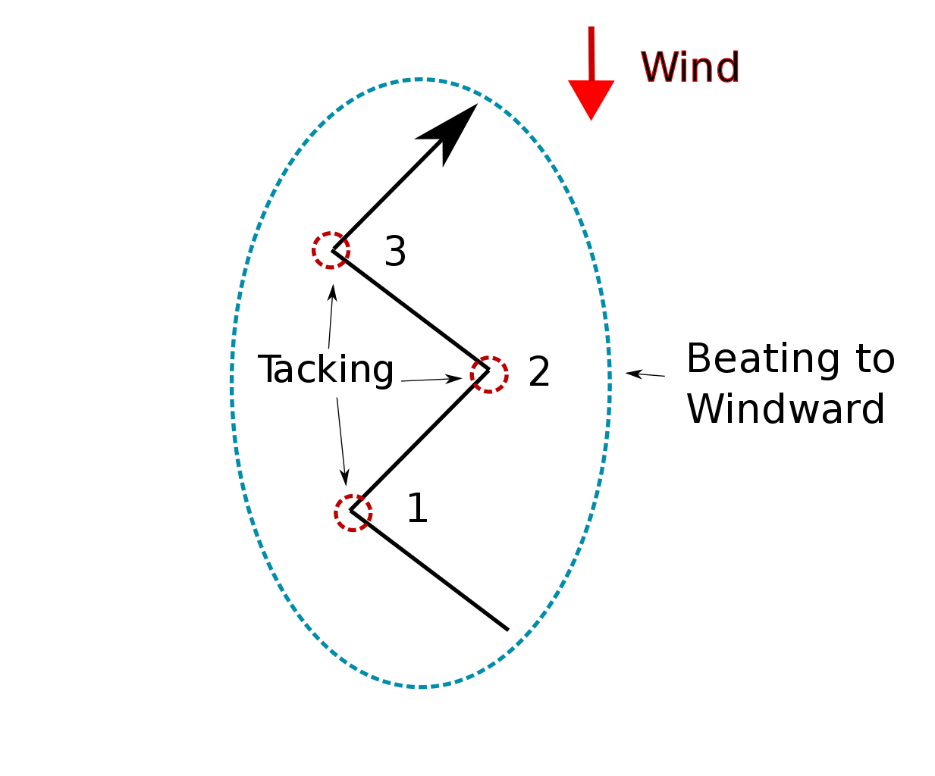


Slide 11


Slide 12
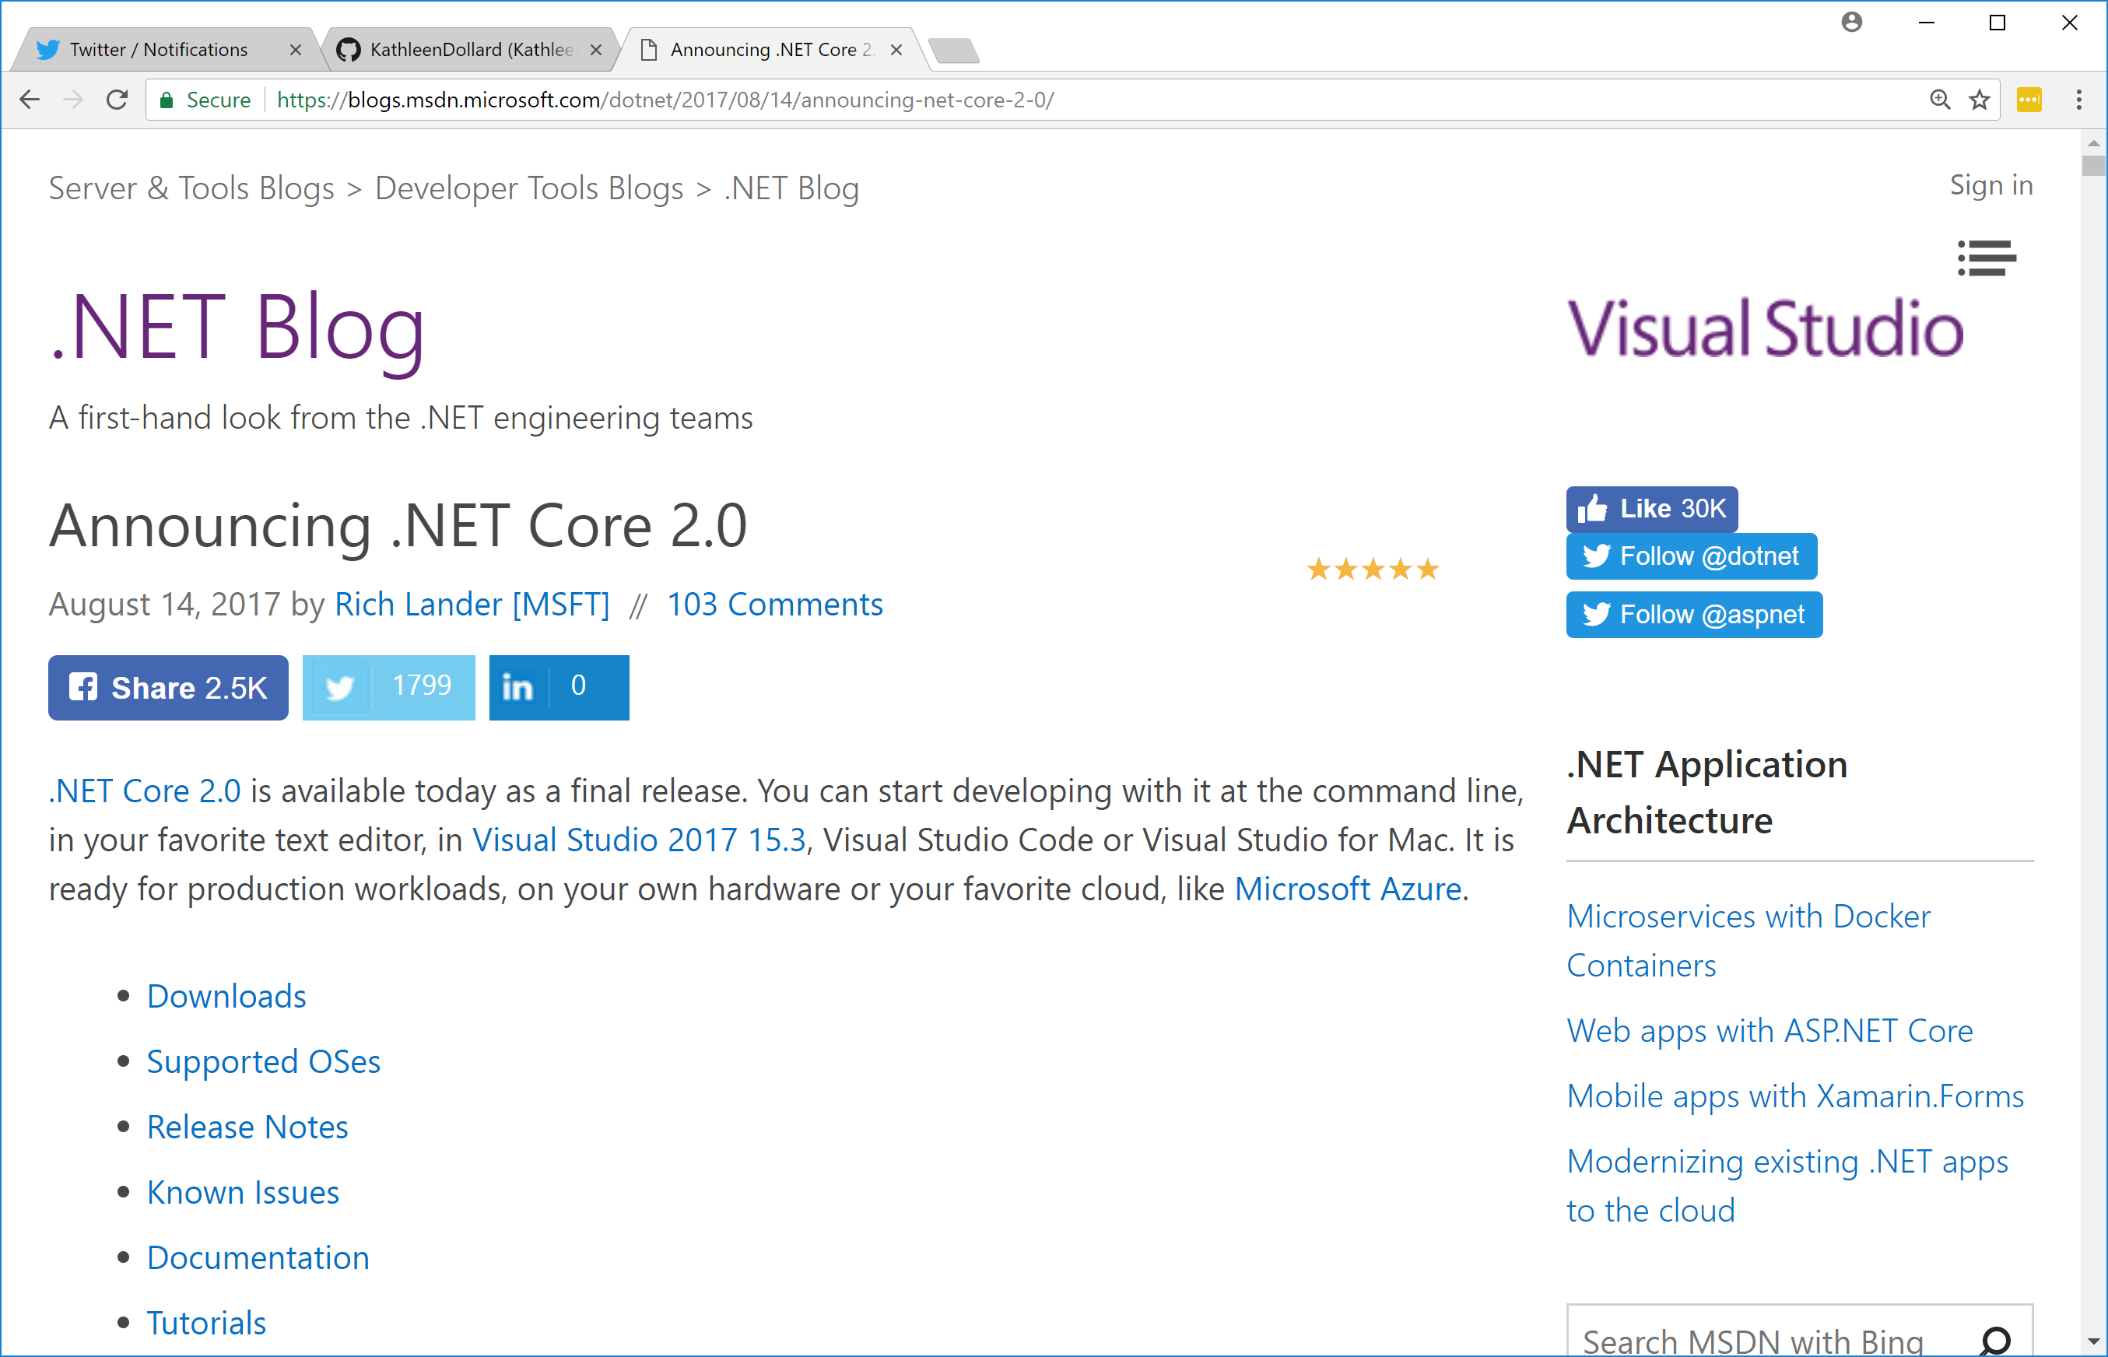


Slide 13

Benefits of .NET Full Framework
Familiar
Lots of apps written in it
Supports WebForms, WinForms, WPF, WCF
.NET Core changes made my boss nervous

Slide 14

Benefits of .NET Core
Smaller and faster runtime
Cross platform
Side by side runtime installation
Lighter development platform
New stuff is on core, or there first
.NET 3
Microsoft is moving workloads to it
WinForms and WPF

Slide 15
WinForms and WPF
This Photo by Unknown Author is licensed under CC BY-SA

Slide 16
WinForms and WPF
Your UI code
Your library code
Windows specific developer pack
.NET Core
This Photo by Unknown Author is licensed under CC BY-SA

Slide 17

.NET Full Framework
The .NET framework we’ve been using for years and love
.NET 4.5.2…NET 4.7.1 (Fall Creator’s Update)
.NET Core
A new cross platform .NET
Doesn’t do Windows stuff
.NET Core 2.0 with .NET Core 2.1 in preview
.NET Standard
A standard for .NET
Definition for what makes something able to be .NET
.NET Standard 2.0, no 2.1 preview

Slide 18
.NET Full Framework implementation
The .NET framework we’ve been using for years and love
.NET 4.5.2…NET 4.7.1 (Fall Creator’s Update)
.NET Core implementation
A new cross platform .NET that doesn’t do Windows stuff
.NET Core 2.0 with .NET Core 2.1 in preview
.NET Standard standard
A standard for .NET
Definition for what makes something able to be .NET
.NET Standard 2.0, no 2.1 preview

Slide 19
.NET Full Framework implementation
The .NET framework we’ve been using for years and love
.NET 4.5.2…NET 4.7.1 (Fall Creator’s Update)
.NET Core implementation
A new cross platform .NET that doesn’t do Windows stuff
.NET Core 2.0 with .NET Core 2.1 in preview
.NET Standard standard or specification
A standard for .NET
Definition for what makes something able to be .NET
.NET Standard 2.0, no 2.1 preview

Slide 20
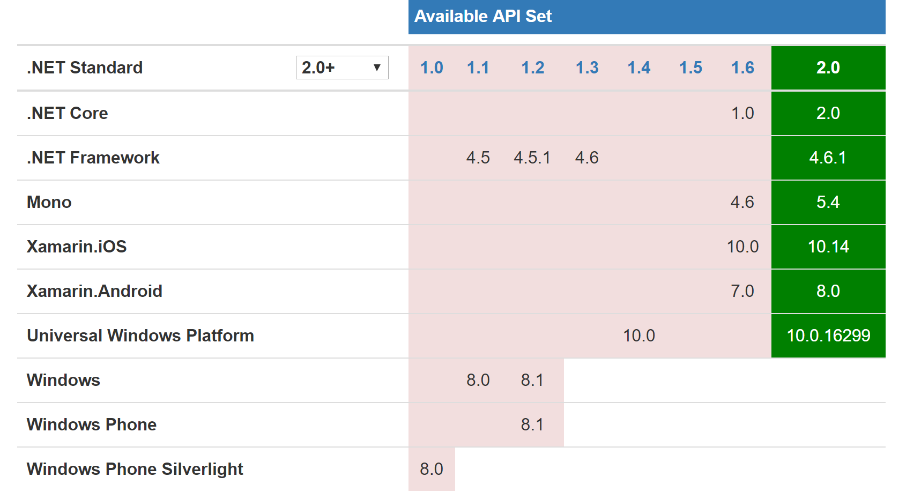
Other implementations

Slide 21
.NET Standard

Slide 22

www.aka.ms/immo

Slide 23
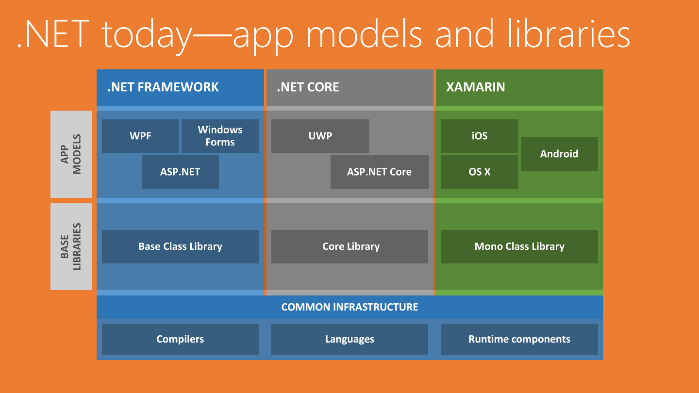
Without .NET Standard

Slide 24
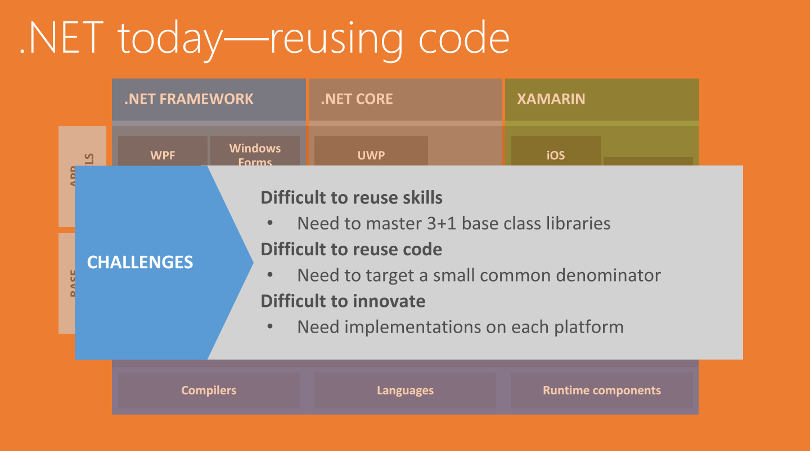
Without .NET Standard

Slide 25
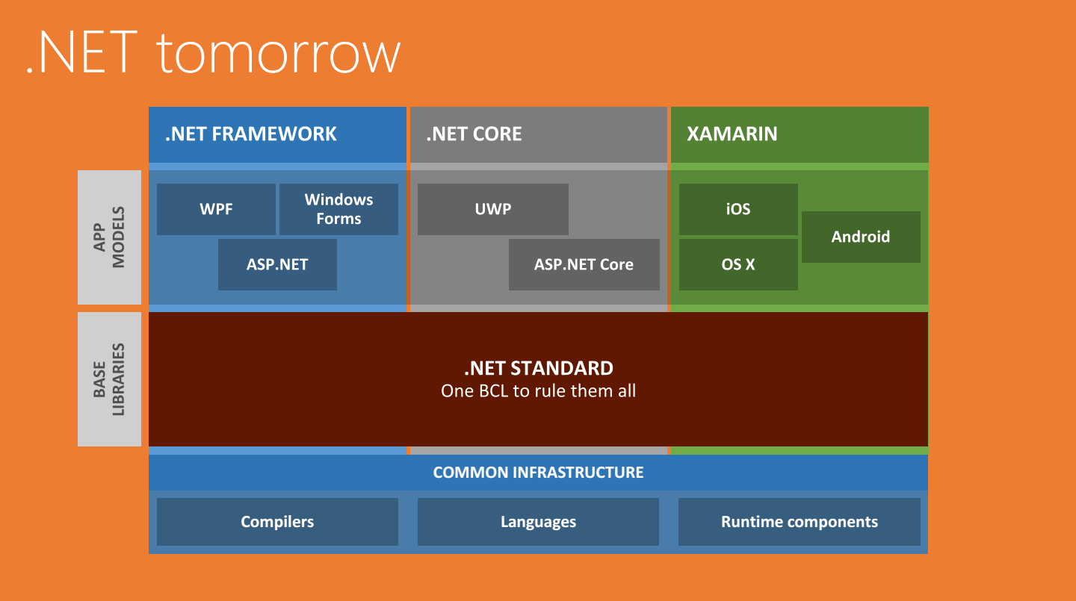
With .NET Standard

Slide 26
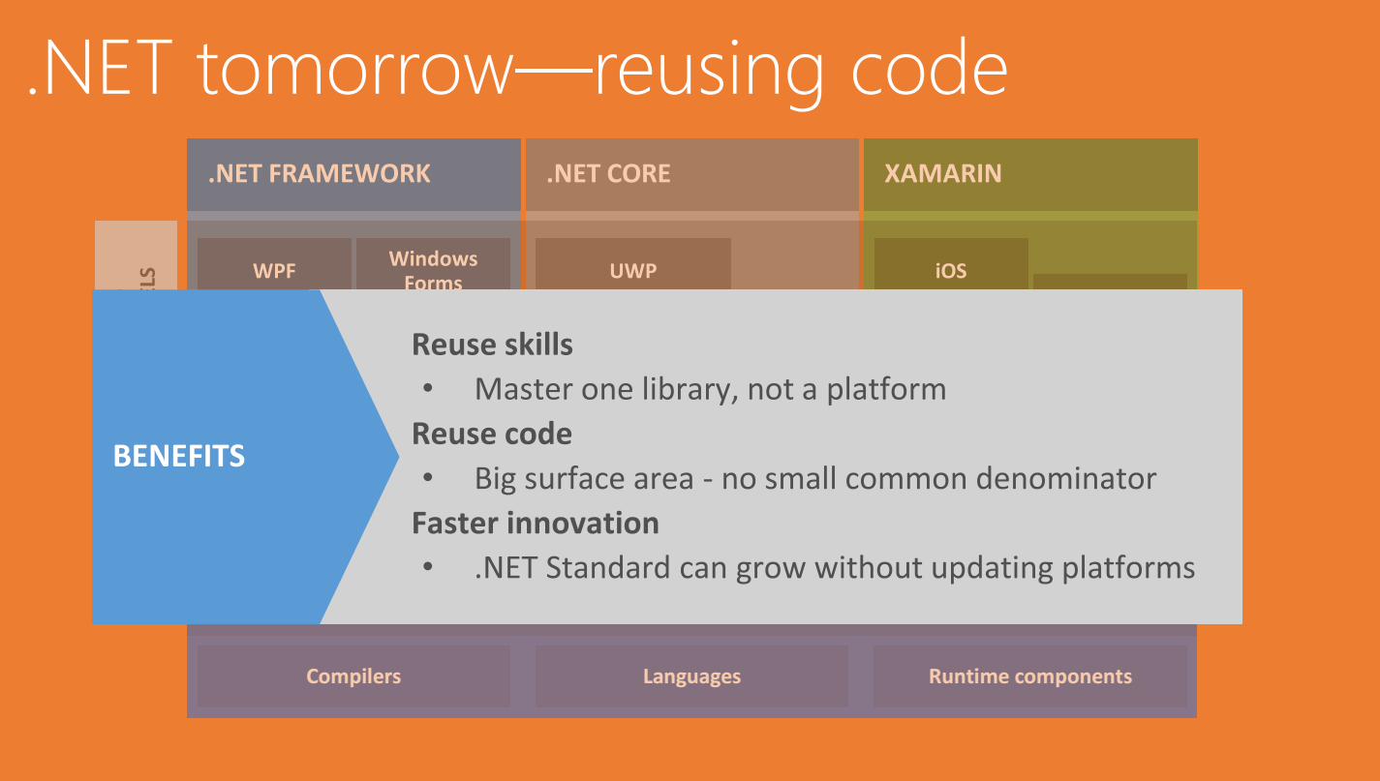
With .NET Standard

Slide 27
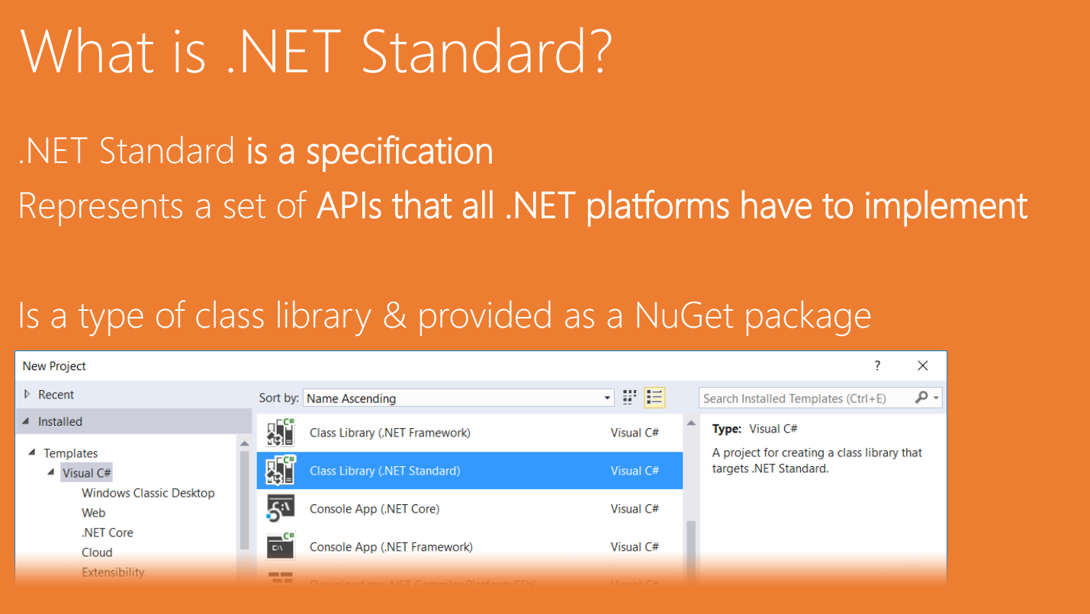
What is .NET Standard
It is a specification
It represents a set of APIs all .NET Standard platforms implement
If you’re class libraries just use Standard, they conform to it
.NET Core supplies a host letting you can .NET Standard libraries

Slide 28

So .NET Standard is a standard, a document written in code

Slide 29
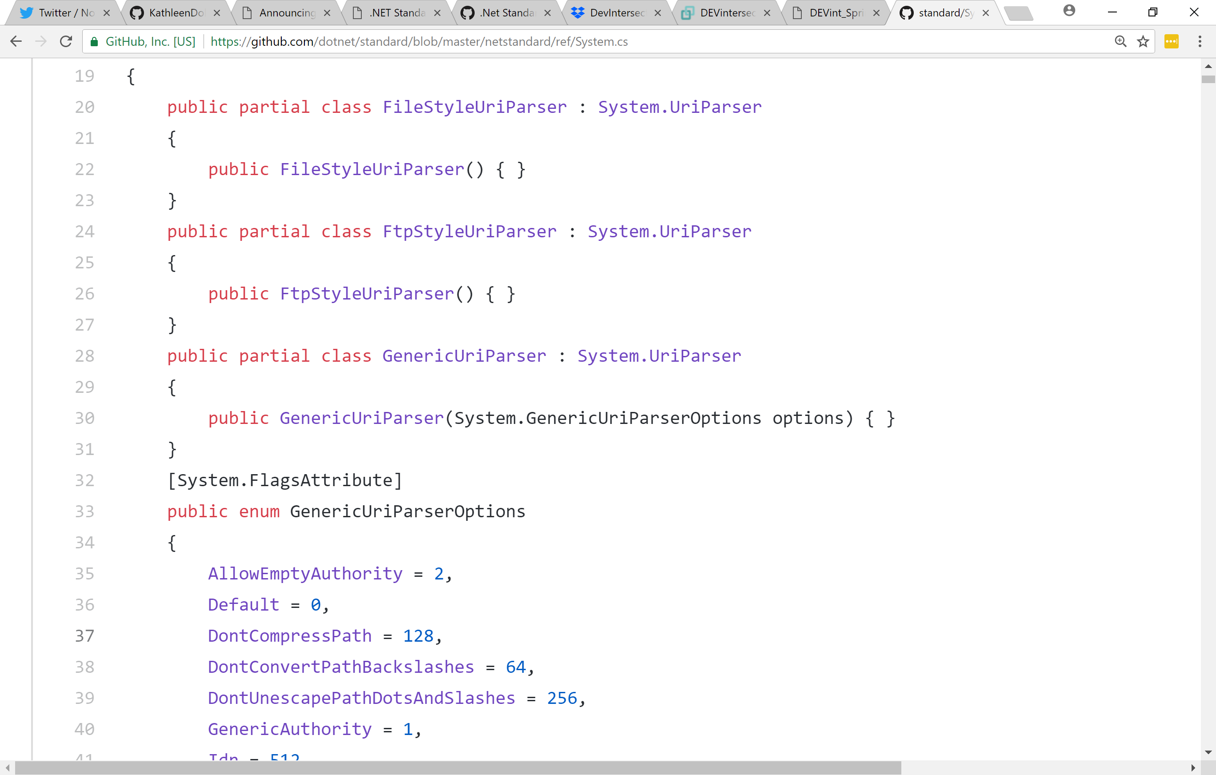




Slide 31


Slide 32

Wat! ***BINARY*** compat
This Photo by Unknown Author is licensed under CC BY-NC-ND

Slide 34
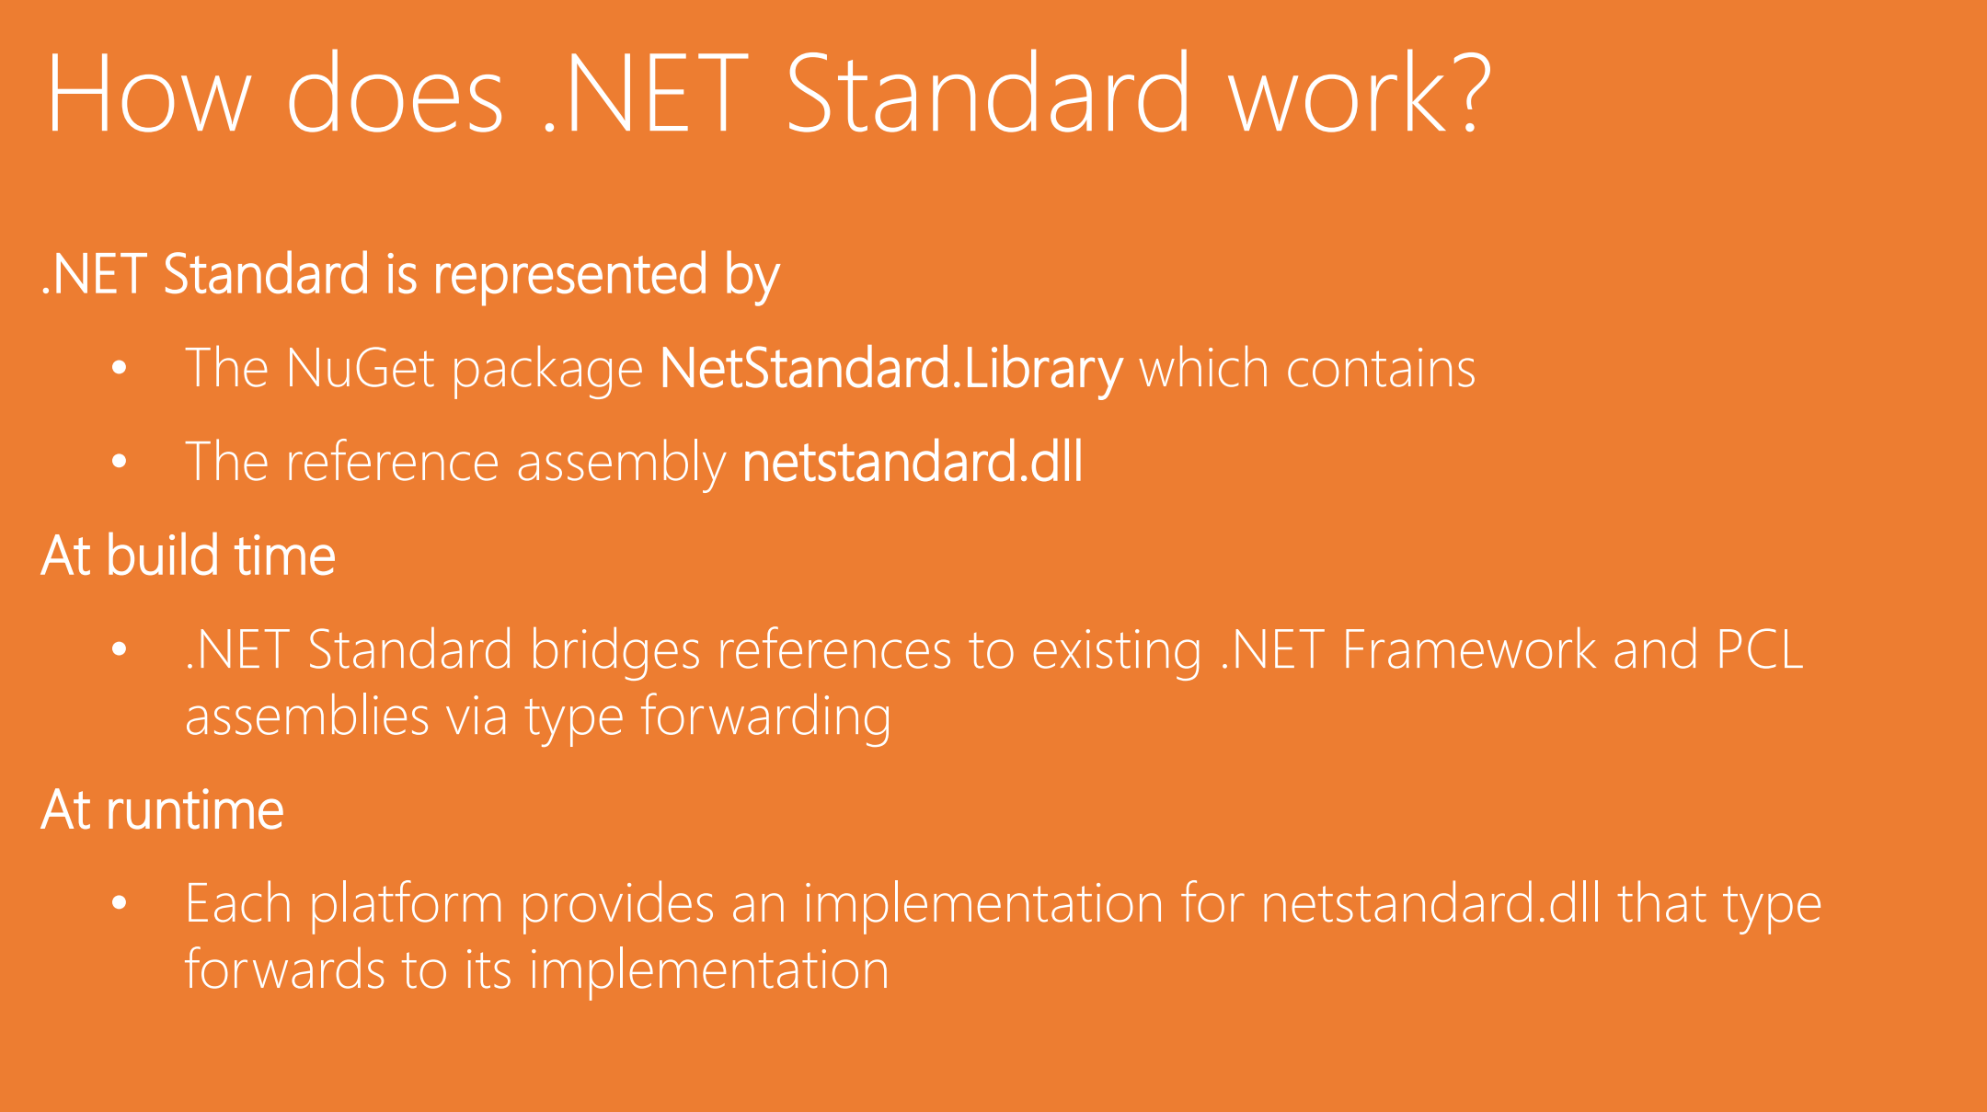

Slide 35

I thought Portable Class Libraries were supposed to do handle platforms?
This Photo by Unknown Author is licensed under CC BY-NC-SA

Slide 36
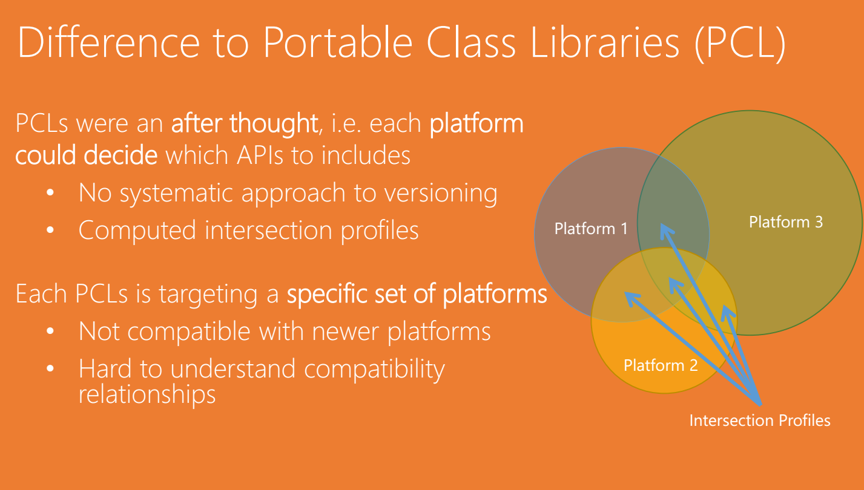

Slide 37

PCL
This Photo by Unknown Author is licensed under CC BY-SA
PCL is driven by other libraries
.NET Standard drives

Slide 38

And now we are going to chat about versions

Slide 39
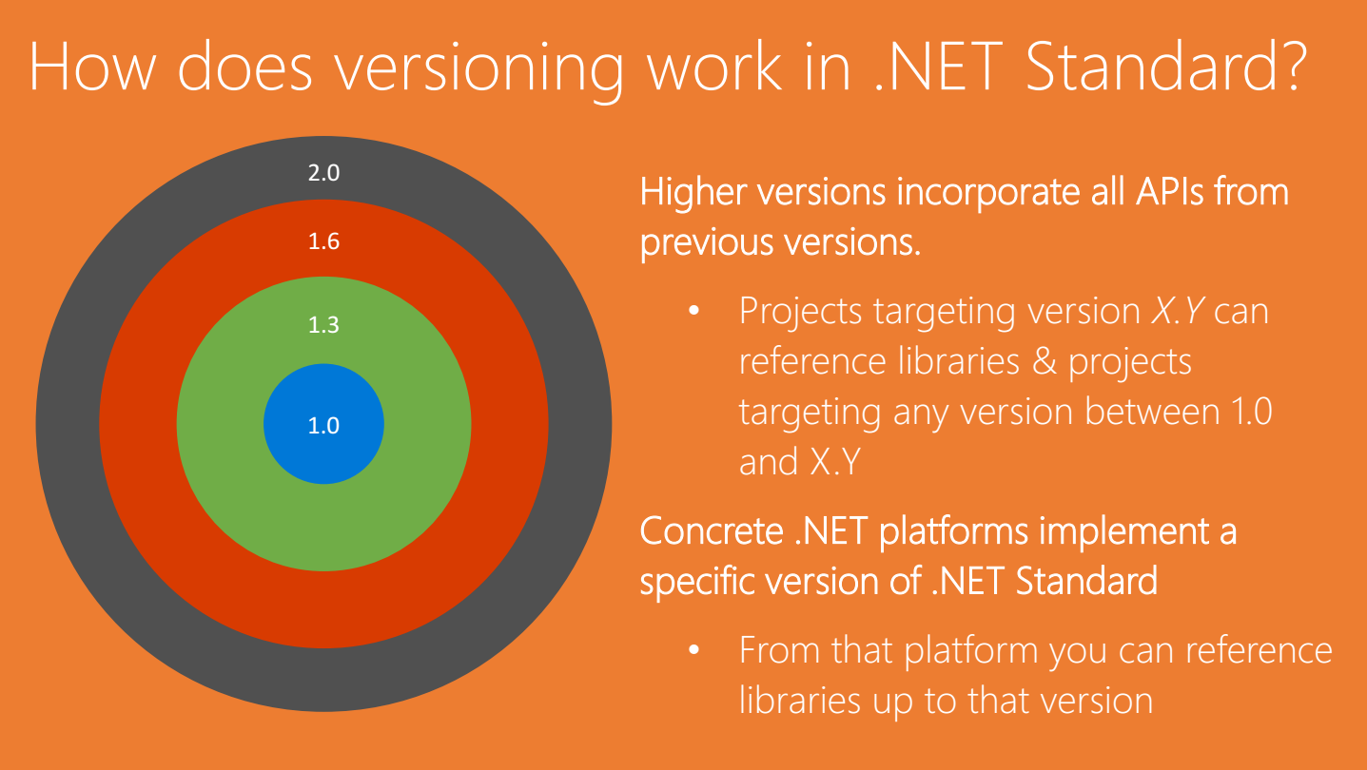

Slide 41
Deciding on a Version
Create a standard library to work with an existing app targeting 4.5.0
Find .NET 4.5.1 in table-that’s the version of .NET Standard you need to use
Create a green-field app with .NET Standard architecture
Use .NET Standard 2.0
Create a library for broadest possible reach
Use the lowest version of .NET Standard that has the features you require

Slide 43
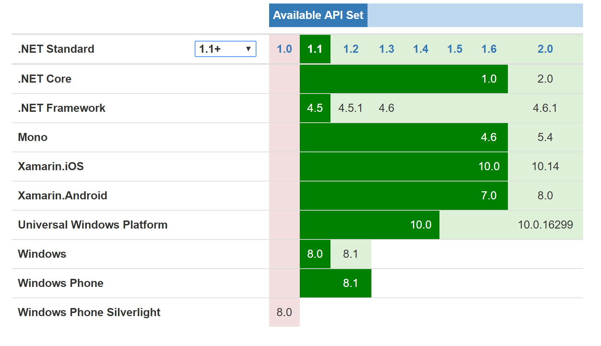

Slide 44
The Version Table
To get the static version table
https://github.com/dotnet/standard/blob/master/docs/versions.md
To get the dynamic version table
http://immo.landwerth.net/netstandard-versions/#

Slide 45
What about the next version of Standard?
It’s a reference assembly, it only evolves on new features
Don’t expect to see patches
Platforms must adapt for a new .NET Standard to be meaningful
Imagine a new column in the table
Initially empty
As each platform adapts, it gets an entry
Don’t worry about seeing another massive change soon
Platforms and Standard now largely align

Slide 46
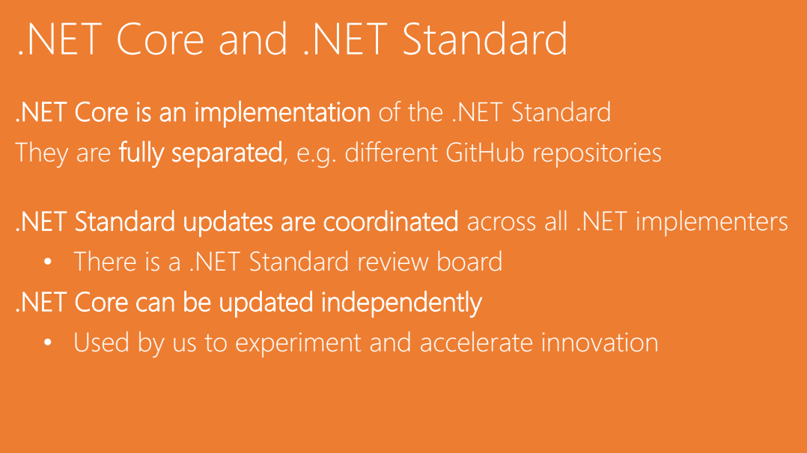

Slide 47
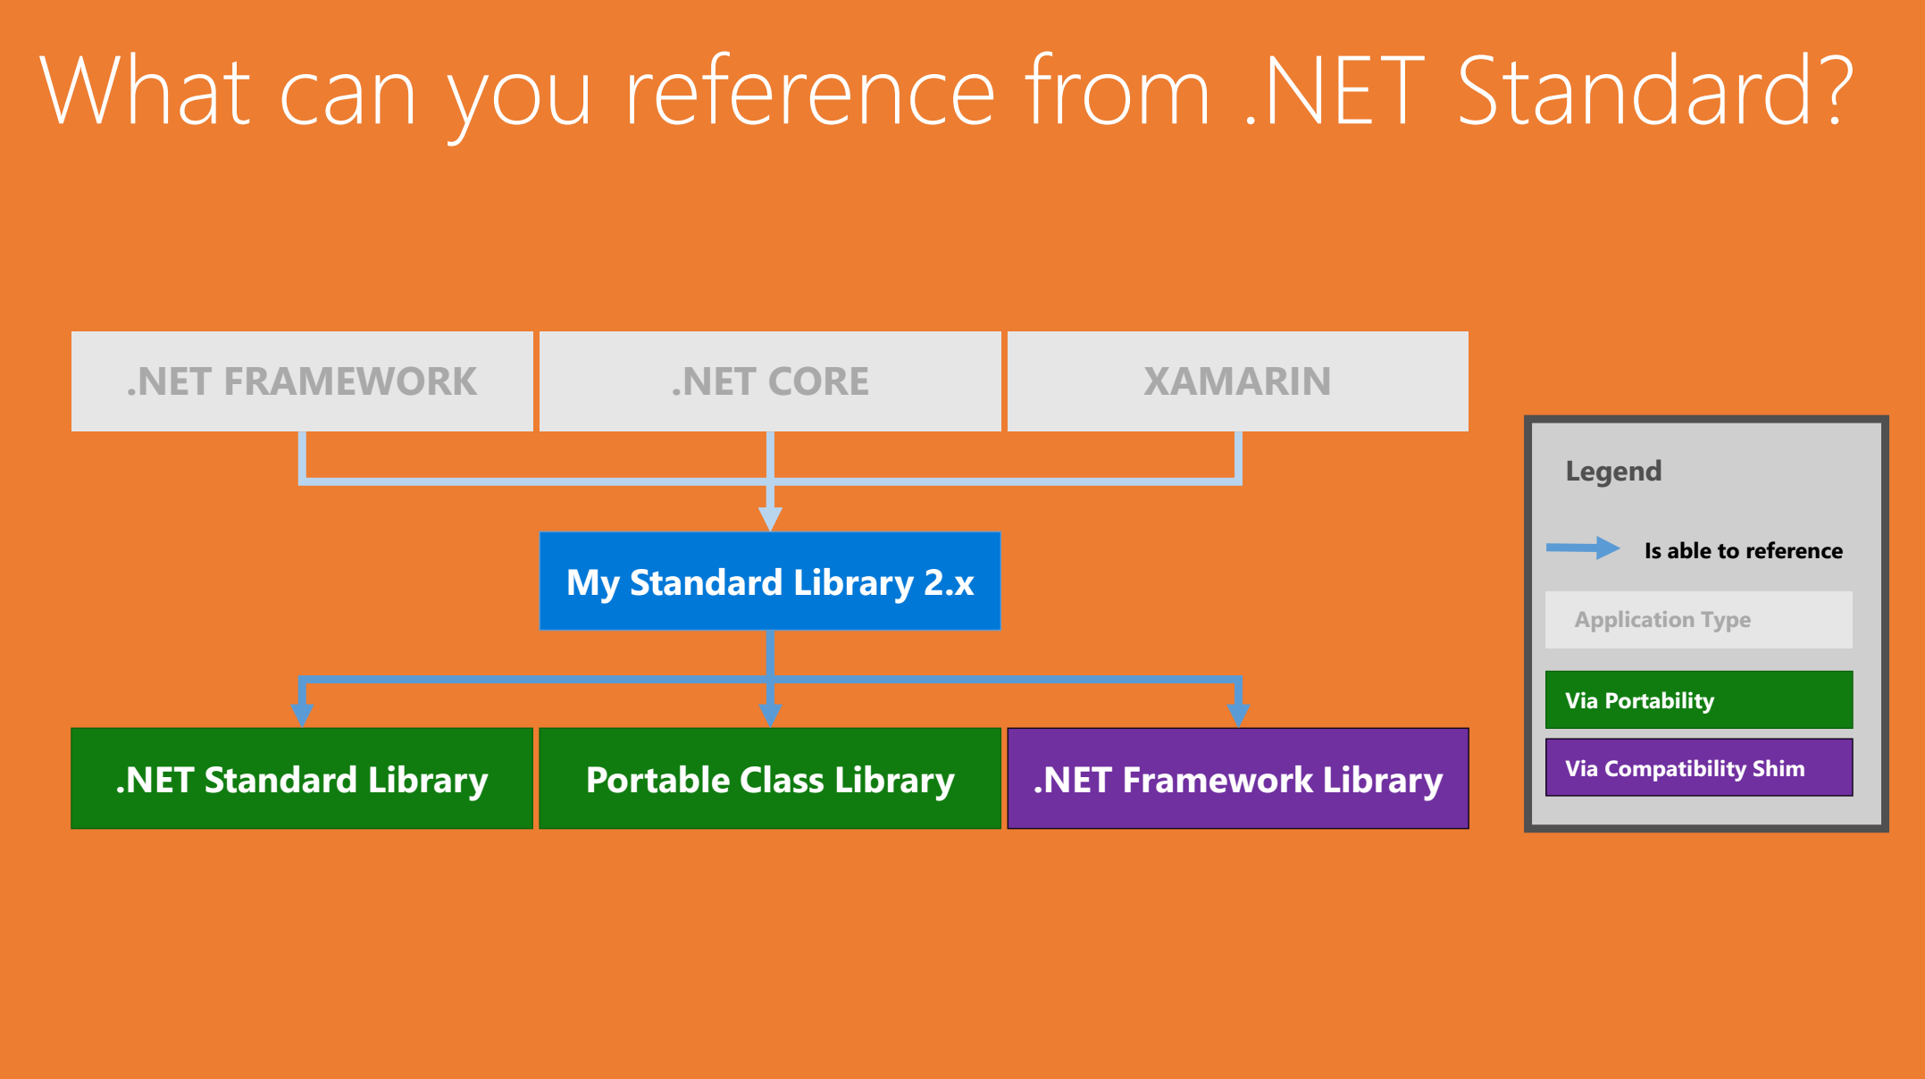

Slide 48

How did they do that!?!
This Photo by Unknown Author is licensed under CC BY-NC-ND

Slide 49
Binding redirects
Type forwarding
Type unification

Slide 50

Binding Redirects – The Problem
MyAssembly.dll 1.0.0
Foo 1.0.1
MyAssembly.dll 2.0.0
Bar.dll
3.5.6

Slide 51
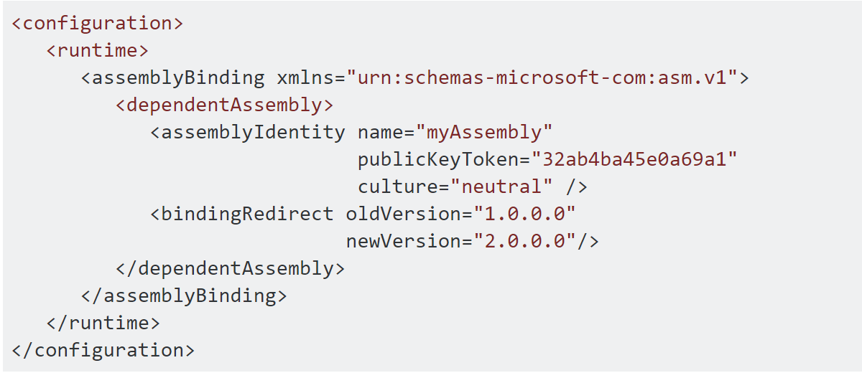
Binding Redirects in app.config
Is it one of these
I want type
Use this other type
Use the type you asked for
https://stackoverflow.com/questions/468825/binding-redirects

Slide 52
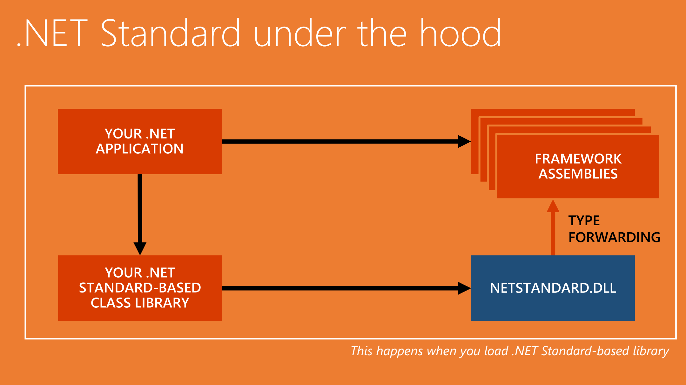

Slide 53
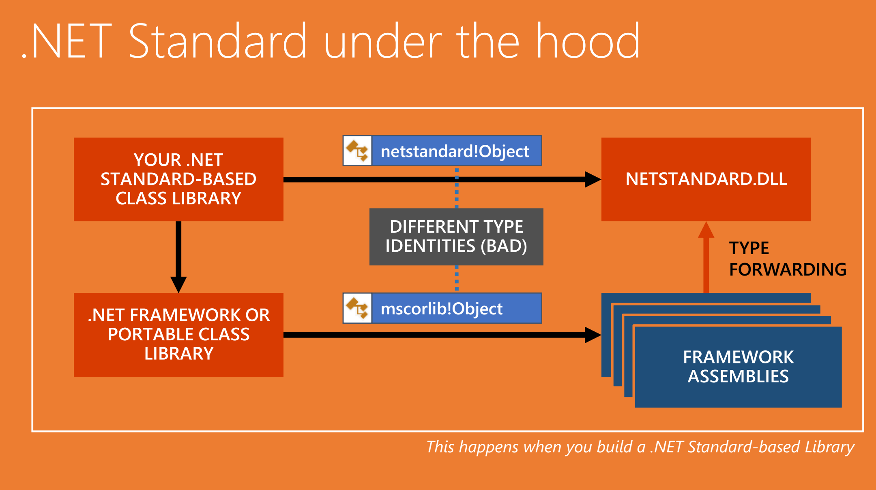

Slide 54

And what about me?

Slide 55
Figuring Out Compatibility
Demo
apisof.net
.NET PortabilityAnalyzer
VS extension and EXE for command – in Gallery
API Analyzer
Analyzer downloaded via NuGet – Microsoft.DotNet.Analyzers.Compatibility

Slide 56
So, whatcha’ going to do?

Slide 57


Slide 58


Slide 59
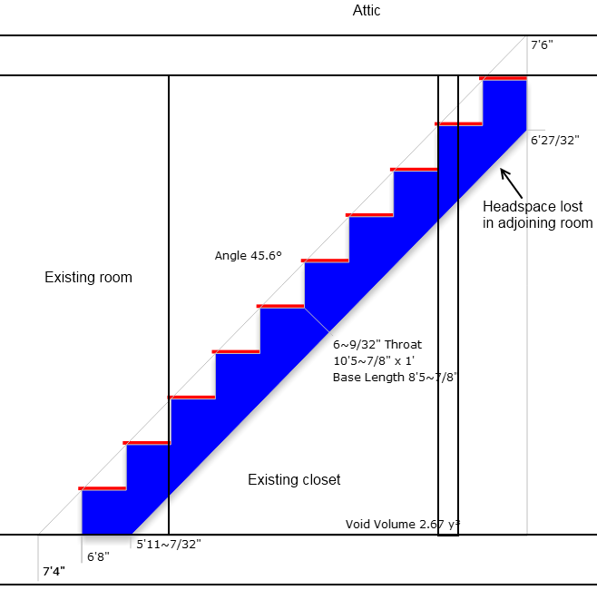

Slide 60
Every step adds value
Organize code

Slide 61

Organize Code
Isolate platform specific code
UI and other code
Consider isolating code by technology
Service code separate from calcuatoins, etc
Touch tech specific via functionally designed interfaces
Consider layers

Slide 62
Every step adds value
Organize code
Understand current compatibility

Slide 63
Understand Compatibility
Use tools to know you align with other platforms
Run these tools regularly to catch issues early

Slide 64
Every step adds value
Organize code
Understand current compatibility
Spike

Slide 65
Spike with Dev Tools and Production
.NET Full Framework had more challenging work
If practical, go to 4.7.1 or higher
Consider multi-targeting
Ensure perf with your tools remains acceptable
Do not jump off the high dive until you know there is water in the pool(*)
(*) and the water is warm and preferably margaritas near by

Slide 66
Every step adds value
Organize code
Understand current compatibility
Spike
Standard when/where needed

Slide 67
Standard When/Where Needed
Standard is awesome!
Allows you to write for cross platform
Maintains a broad and effective API surface (2.0)
Has a broad reach (1.n)
Defines a common future
Your projects can have multiple targets
Compile for .NET Standard for most platforms
Also, compile for .NET Full Framework if that makes sense

Slide 68
Every step adds value
Organize code
Understand current compatibility
Spike
Standard when/where needed

Slide 69

You got this!
This Photo by Unknown Author is licensed under CC BY-SA

Slide 70


Slide 71

Questions? .NET Standard kdollard@microsoft.com
@kathleendollard
References
Immo Landwerth on You Tube: aka.ms/immo

